Slide 1
SPFx Custom Localization
Localizing a SPFx Web Part for the page's, rather than user's, language

Slide 2

Brian McCullough
"Long time listener, first time caller..."
https://www.linkedin.com/in/brianpmccullough
https://github.com/brianpmccullough
http://brianpmccullough.bsky.social
https://twitter.com/bpmccullough

Slide 3
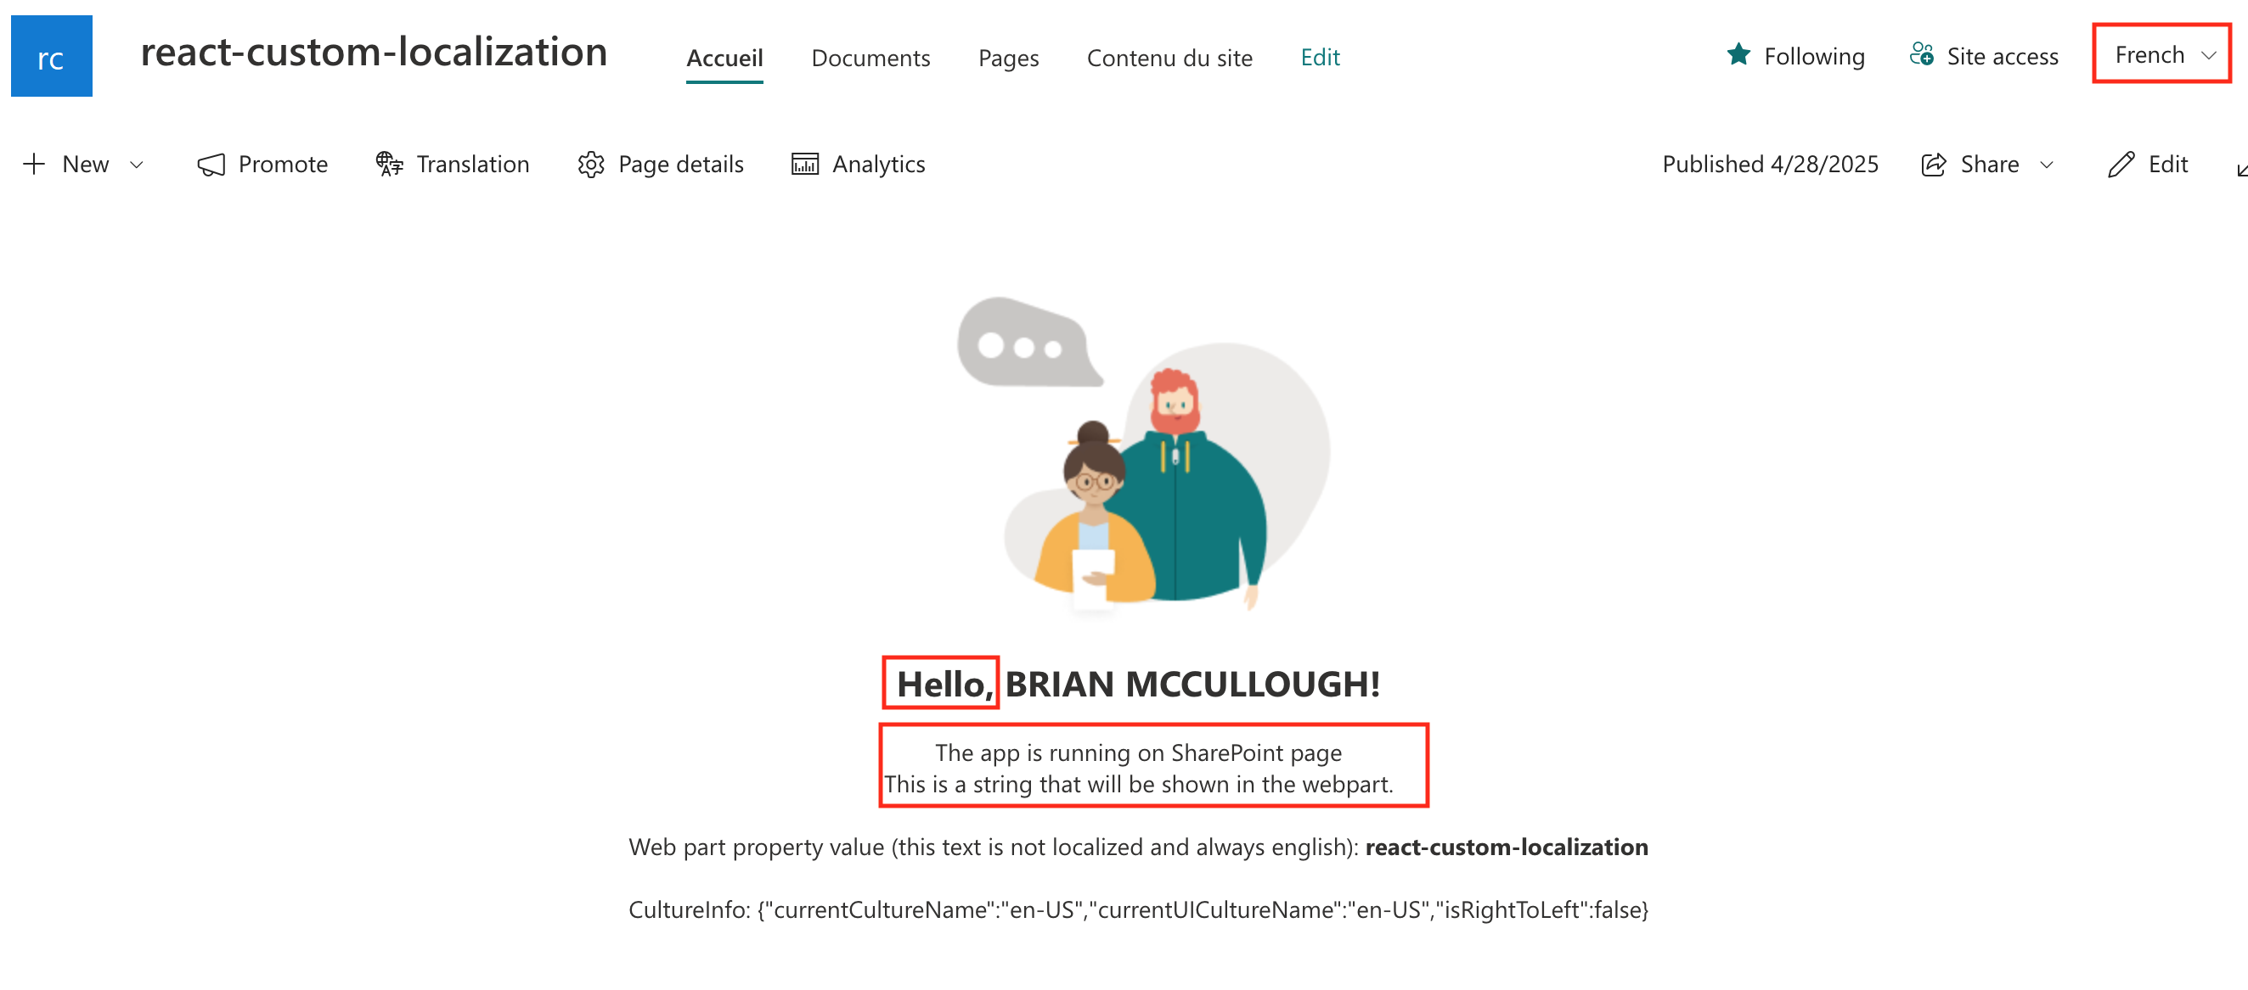
The Problem

Slide 4
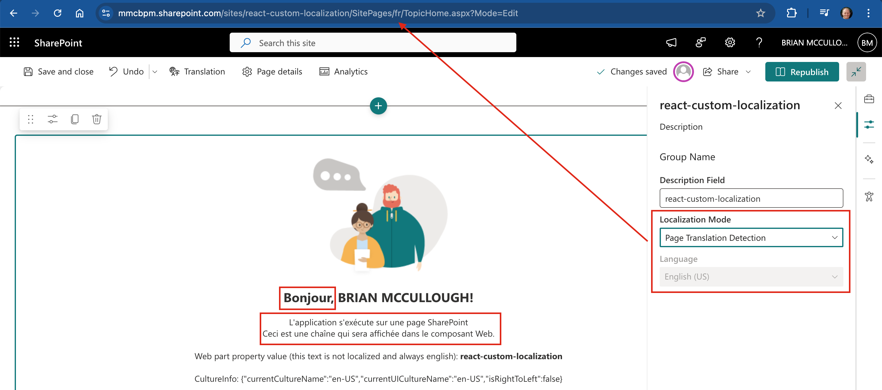
The Solution

Slide 5
The Solution
https://github.com/pnp/sp-dev-fx-webparts/tree/main/samples/react-custom-localization

